Slide 1



SMART INDIA HACKATHON 2026
  Problem Statement ID – 26161
  Problem Statement Title - Dam Break Inundation Modelling Using Hydrodynamic Modelling of any River
  Theme - Disaster Management
  PS Category- Software
  Team ID- 166019
  Team Name - InVictus_165

Slide 2
PROBLEM STATEMENT
InVictus_165
Dam Break Inundation Modelling Using Hydrodynamic Modelling of any River
PROBLEM
Sudden dam breaks or river blockages can release huge amounts of water, causing destructive flash floods. There is a need to simulate these events and quickly identify the areas that may be inundated, so that authorities can take effective disaster-management decisions.
SOLUTION
Build a generalized flood simulation platform that predicts how water spreads after a dam break using SPH and Delft3D. It visualizes the predicted inundation on a GIS-based dashboard and provides GIS-ready outputs to support disaster-response planning.
IDEA
INNOVATION
Build a generalized platform to simulate dam-break floods and visualize the affected areas.
Combine SPH + Delft3D + 3D GIS visualization + scenario comparison + SHP/KML outputs in one framework.
@SIH Idea submission- InVictus_165
2
Notes:
2

Slide 3
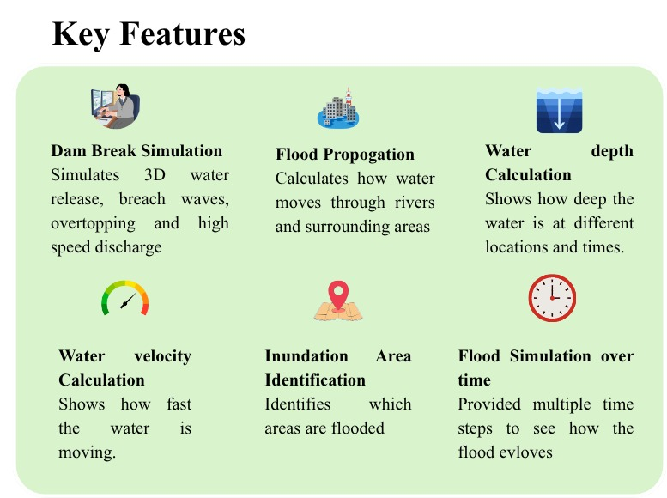
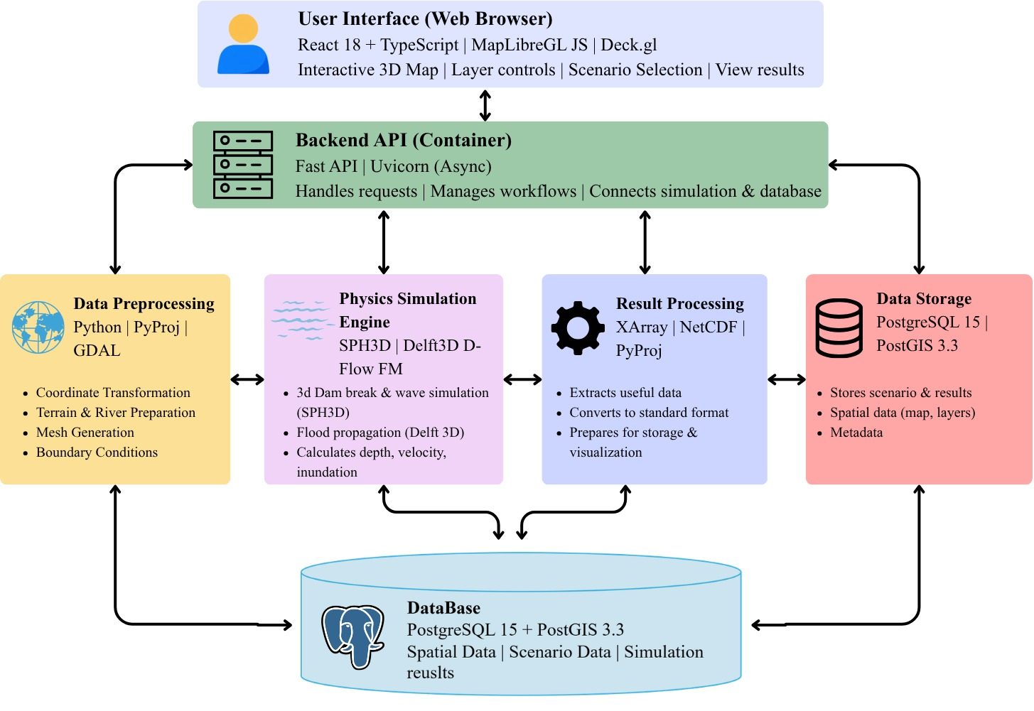
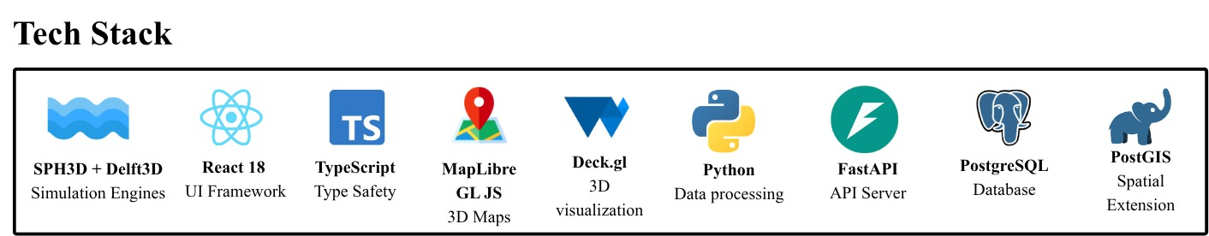
TECHNICAL APPROACH
InVictus_165
Project Completion Status : 45 %
Tech Stack
GitHub Link :
Video Link :
@SIH Idea submission- InVictus_165
3
Notes:
3

Slide 4
FEASIBILITY AND VIABILITY
InVictus_165
Feasibility of the Idea
  Uses proven technologies like SPH, Delft3D, DEM and GIS.
  Open-source tools and free data help reduce cost.
  The system can be used for different dams and rivers.
SDG Goals
SDG 11 – Sustainable Cities and Communities
SDG 13 – Climate Action
SDG 6 – Clean Water and Sanitation
SDG 9 – Industry, Innovation and Infrastructure
Viability of the Idea
  Provides flood maps and risk information for disaster management.
  SHP/KML outputs can be used in GIS software.
  The system can be reused in different regions with new data.
Potential Challenges & Risks
  Required data may not always be available or accurate.
  Simulations may need high computing power and time.
  Results may differ from real floods due to uncertain conditions.
Strategies to Overcome Challenges
  Use multiple data sources and check the data before simulation.
  Use GPU and optimized settings to speed up simulations.
  Compare results with past flood events and satellite data and improve the model
@SIH Idea submission-InVictus_165
4
Notes:
4

Slide 5

IMPACT AND BENEFITS
InVictus_165
Direct Targeted Users / Beneficiaries
  Disaster management authorities and government agencies
  Dam and water resource departments
  Local communities in flood-prone areas
Strategic Impact
  Enables faster flood risk assessment.
  Improves evacuation and emergency planning.
  Supports data-driven disaster response.
Strategic Benefit
  Provides clear flood inundation maps.
  Helps identify high-risk areas.
  Supports scenario-based planning for different dam-break conditions.
Social and Economic Benefits
  Helps reduce loss of life and property.
  Supports better allocation of rescue and relief resources.
  Reduces potential economic losses from flood damage.
@SIH Idea submission- InVictus_165
5
Notes:
5

Slide 6
RESEARCH AND REFERENCES
InVictus_165
  SWOT Satellite Observations of the Kakhovka Dam Break Flood & Outburst Flood Models (April 2026)
  Very recent research showing how satellite observations can be used to validate and assess dam-break flood models, which supports your satellite/GEE component.
  Research Paper – Geophysical Research Letters
  Hydrodynamic modeling of dam breach floods using satellite data, UAVs & Google Earth Engine (August 2024)
  Directly relevant to your use of DEM + satellite data + GEE + hydrodynamic modelling + inundation maps.
  Research Paper – Springer
  A Smoothed Particle Hydrodynamics Approach for One-Dimensional Dam Break Flow Simulation (August 2024)
  Useful as a reference for the SPH methodology for dam-break flow simulation.
  Research Paper – Journal of Civil and Hydraulic Engineering
  Investigating Sediment Load by Dam-Break Floods Using a Meshless Two-Phase SPH Model (July 2024)
  Relevant to your proposed SPH-based dam-break simulation, particularly for complex flood and sediment behaviour.
  Research Paper – Wiley
@SIH Idea submission- InVictus_165
6
Notes:
6

